Slide 1
METEOROLOGICAL SATELLITE : SENSING PRINCIPLES, DATA COLLECTION AND ANALYSIS
by YOUNKAP NINA Duplex Air Traffic Controller - MEng Degree in Computer Science
MAROUA-SALAK INTERNATIONAL AIRPORT

Slide 2
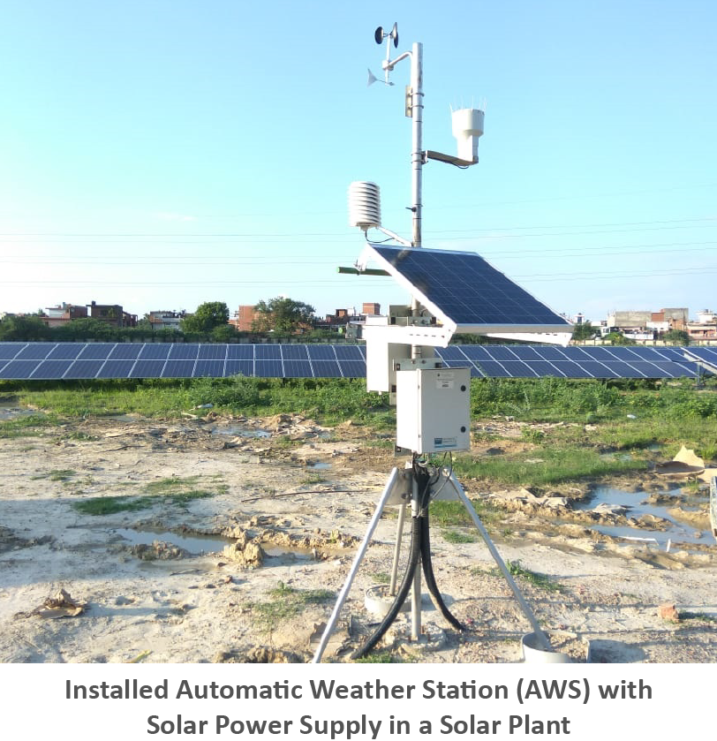
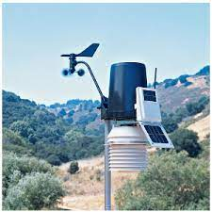

BASIC PRINCIPLES OF SATELLITE REMOTE SENSING
An automatic weather station (AWS) is defined as a “meteorological station at which observations are made and transmitted automatically”.
In 1997, the AWS network was upgraded by induction of 15 new state of art microprocessor/microcontroller-based systems across India under Test and Evaluation mode.
During the year 2006-07, a network of 125 AWS has been established across India.

Slide 3
Real time: In the case of real-time AWS, data is available almost in near real time according to synoptic requirements.
Non-Real time: In the case of Non –real time (off line), AWS record the data as per user-defined time intervals and store them in the data logger.
Interrogative AWS which provides the data when the station is contacted through modem / cable link for retrieval of data during adverse weather conditions.
TYPES OF AWS
Real time
Non –real time
Interrogative AWS

Slide 4

PARTS OF AN AUTOMATIC WEATHER STATION
Datalogger
GPS
A Datalogger is an electronic device that records data over time or in relation to location either with a built in instrument or sensor or via external instruments and sensors.
GPS antenna are used for Datalogger clock time synchronization.
YAGI Antenna
Battery/Charger
The AWS are operated with a DC power supply from a 12V / 65 AH Sealed Maintenance Free (SMF) battery which is float-charged by the solar panel of 40W capacity.
Yagi antenna is used for up-linking the data to the satellite from the remote field sites.

Slide 5
COMMUNICATION SYSTEM OF AWS
Schematic Diagram of Communication System of AWS

Slide 6


PARTS OF COMMUNICATION SYSTEM OF AWS
GPRS Based AWS Model
TDMA Technology
GPRS based Data logger used for AWS:
Dual way communication
Quality Control at field Level
Each TDMA type of transmitting AWS / ARG has a unique GPS synchronized time of transmission stamped on the body of the system at the time of installation
GPRS Communication
Parabolic Antenna for Down Link
GPRS is a best-effort service, implying variable throughput and latency that depend on the number of other users sharing the service concurrently, as opposed to circuit switching
The parabolic antenna is essentially an electromagnetic wave lens which focuses the RF energy (signal) into a narrow beam and converges on a single point known as focus.

Slide 7


SENSORS USED IN AWS/Agro AWS/ARG
Temperature Humidity Sensors
Wind Sensors
It measures the time it takes an ultrasonic pulse of sound to travel from the North transducer to the South transducer, compares it with the time for a pulse to travel from S to N transducer.
Range is 0-116 knots for wind speed &
0-359° for wind direction.
The sensing element for temperature is a high precision PT 100(platinum resistance) sensor.
The measuring range of temperature –40° to +60°C corresponds to an output of 0 to 1V.
Pressure Sensors
Pressure sensor is a device for pressure measurement of gases or liquids .
Low power design makes it ideally suited for remote monitoring applications
Rainfall sensor
The sensor is the tipping bucket mechanism and is mounted at a height of 0.6 to 1 m. The collector diameter is 20 cm.
So 15.7 cc (product of collector area and resolution) of rain water corresponds to 0.5 mm of rainfall.

Slide 8



The Soil Moisture Sensor is a Stevans hydra probe using a SDI-12 output and the unit of measurement of soil moisture is water fraction by volume(wfv).
The Hydra soil moisture probe determines soil moisture and salinity by making a high frequency (50 MHz) complex dielectric constant measurement which resolves simultaneously the capacitive and conductive parts of a soil's electrical response
Soil sensor
Sunshine Duration sensor
CSD3 measures sunshine duration. Sunshine duration is defined by WMO as the time during which the direct solar radiation exceeds the level of 120 W/m².
It has no moving parts and uses 3 photo-diodes with specially designed diffusers to make an analogue calculation of when it is sunny

Slide 9
AWS setting up guidelines
A 10 m galvanized iron tower with red oxide coating is used to mount the system enclosure and sensors. The tower is erected on a concrete foundation of 3-5 feet depth depending on site requirement.
The tower is supported by three guy ropes the NEMA 4 enclosure is fixed on the tower at a height of about 1.8 m. Temperature sensor is mounted at 1.2 to 2.0 m above ground.
Wind measurement is taken at a height of 10 m above ground. Wind sensor is mounted on a shaft at least 3 feet from the tower.

Slide 10



The pyranometer is mounted on a shaft at a height of approximately 1.8 m above ground. The shaft for pyranometer is kept to the south to minimize the effect of tower shadow.
The crossed Yagi antenna is installed on a tower at an approximate height of 6-7 m.
The antenna elevation and azimuth angle depends on latitude and longitude of the field site and the satellite longitude (74 E). For the AWS network the azimuth angle is greater than170.
The antenna is therefore mounted on the tower facing to south. The tipping bucket rain gauge is installed at a minimum distance of 3 m from the tower.
The height of the collector is approximately 0.6 to 1.0 m above ground depending upon the site requirement.

Slide 11
APPLICATION OF AWS
1.
2.
3.
Standard automatic weather station: This kind of weather station can measure air temperature, humidity, rainfall, wind direction, wind speed, air pressure, ground temperature, radiation, sunlight, evaporation and other parameters. It is use in forecasting, nowcasting, NWP models etc.
Automatic weather station for anemometer tower of wind farm: The automatic weather station for anemometer tower of wind farm acquires wind speed, wind direction, temperature, humidity, air pressure etc.
Automatic Weather Station for Status Monitoring of Power Transmission Line: This kind of weather station carries out real-time monitoring of wind speed, wind direction, temperature, humidity, air pressure, rainfall, optical radiation and other meteorological elements for Weather Online Monitoring System of Overhead Transmission line

Slide 12
CONCLUSION AND ADVANCEMENT
Records of daily weather conditions have been kept for 200 years and more, of course, but traditionally have always required a diligent and dedicated human observer to record readings from manual instruments at a fixed time, without fail, every single day.
BENEFITS OF AWS
Routine daily maintenance chores (e.g. emptying the rain gauge) are done automatically.
AWS stations can automatically record maximum and minimum values for a range of weather parameters through each day and keep track, for example, of total monthly and yearly rainfall.
Readings can be easily taken direct from the console display.
A data logger and PC can be readily linked to the station so that all weather data is automatically logged.

Slide 13

ACKNOWLEDGEMENT
I am grateful to Shri S. SENGUPTA, Scientist-E, RMC Kolkata, who has guided me on this project with his immense knowledge and experience.
I am grateful to officers and staffs of training section for the support extended throughout the training period.

Slide 14
THANK YOU……

